Slide 1
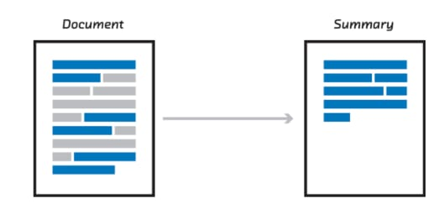

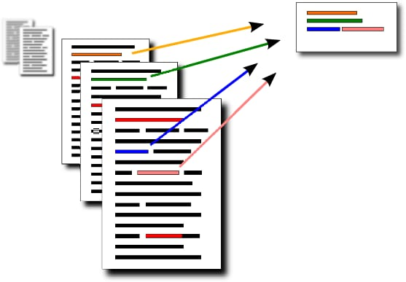
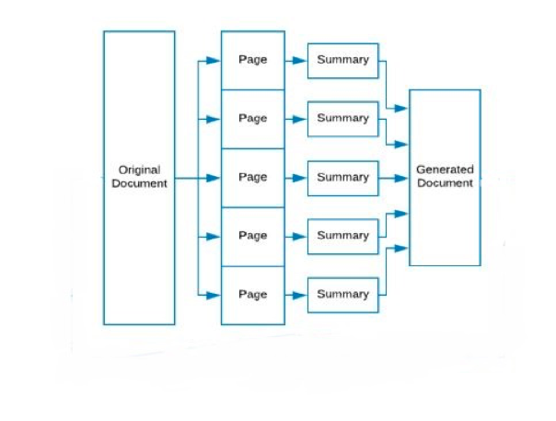
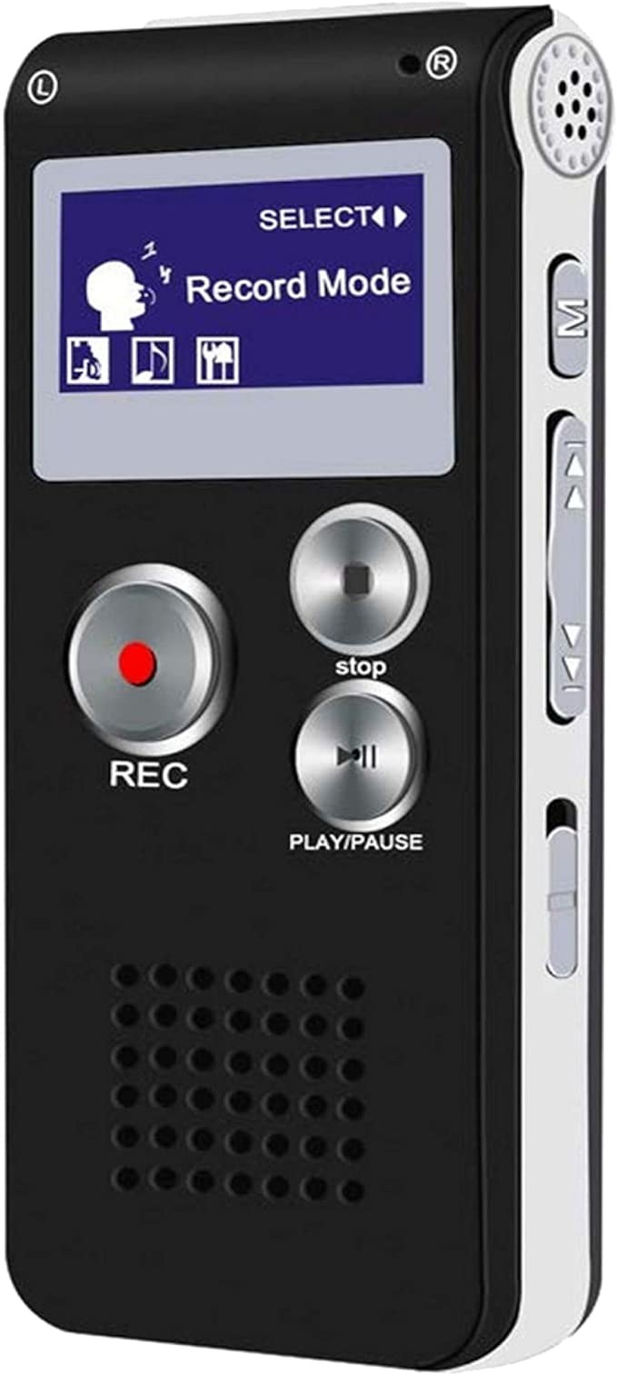



MEETING SUMMARIZER USING NLP
Work of Text Summarizer : Creates a concise representation that retains most relevant information w.r.t particular aspect.
What makes our project different ????
Speech to Text
Document to Summary
INPUT can be :
OR
OR
Basic Text Summarization
Audio
Document (Single page)
Document (Multiple pages)
Applications of Summary Generator :
College Seminars
Business Meetings
Doctors

Slide 2
Flow of the process
Additional Features
App
Further summary can be converted to speech
Video
Audio
Document
Language Translation
Text
Summarized Text

Slide 3
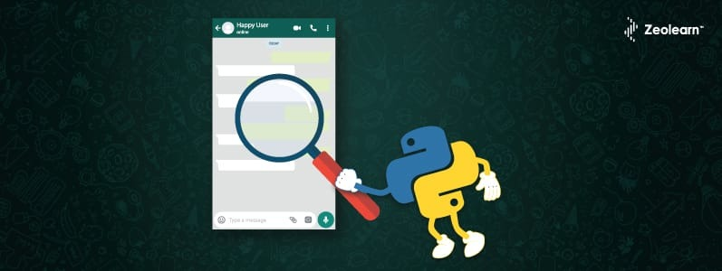
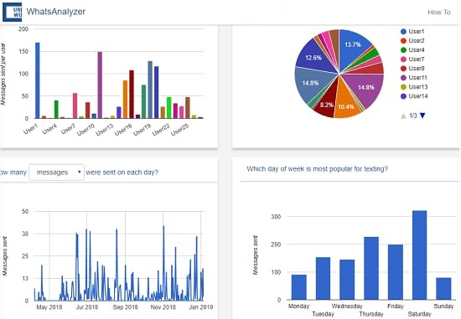
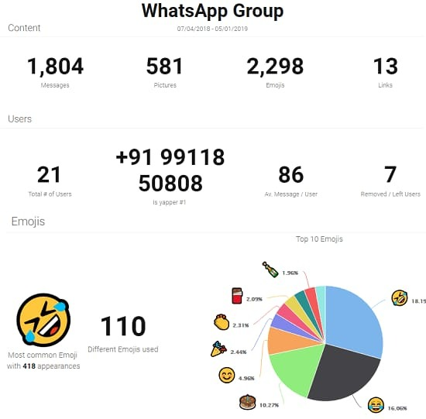
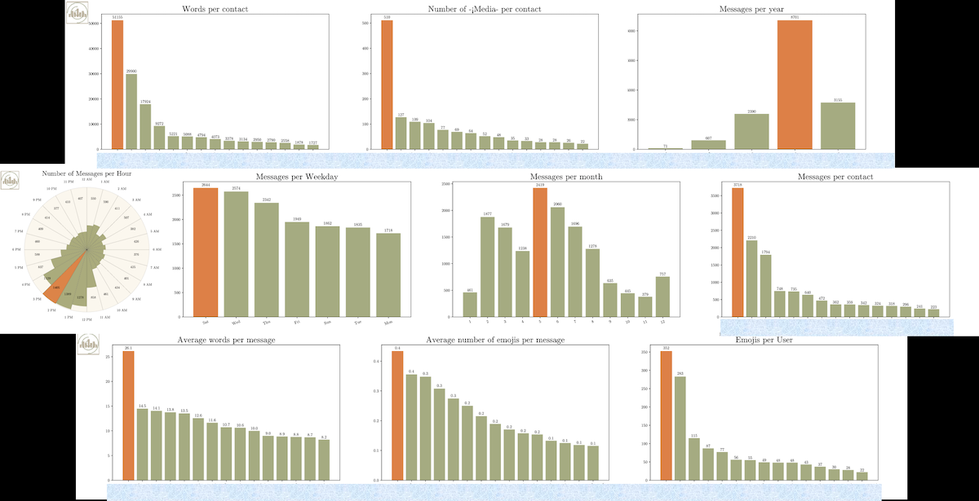
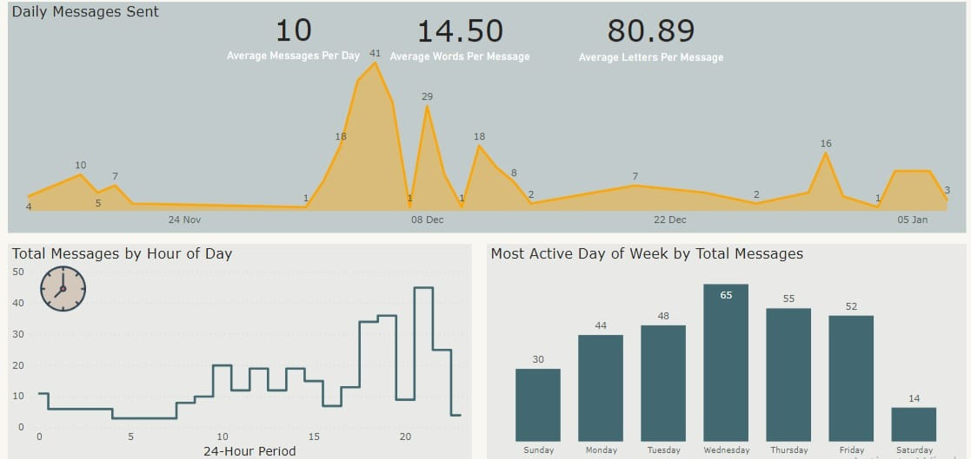
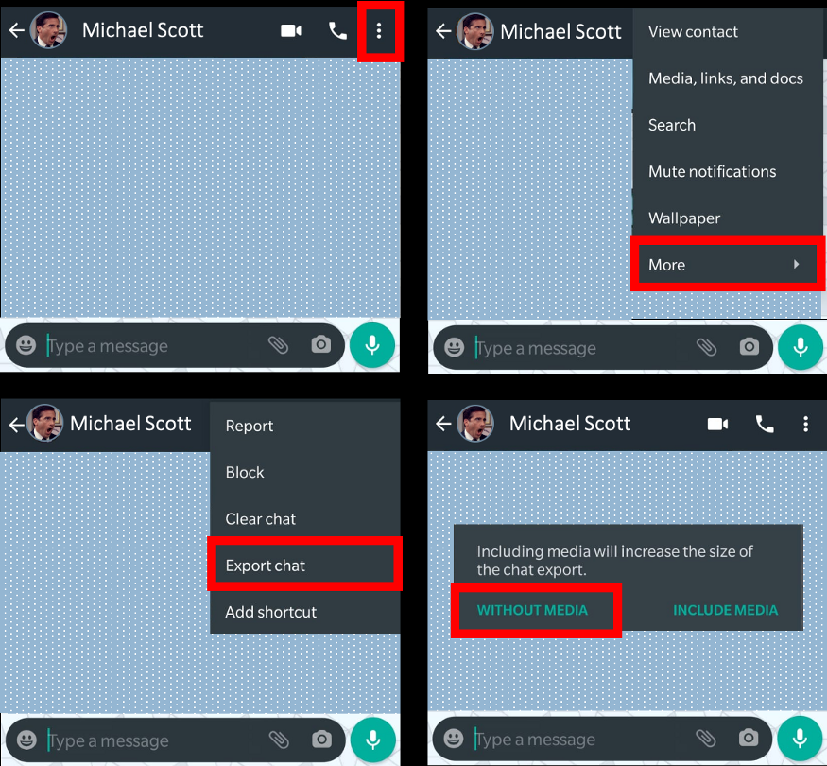
WhatsappChat Analyzer
Analyze whatsapp chat in the form of interesting graphs
Export the WhatsApp chat you like to analyze.
Output of the analysis :
Number of messages per contact
Number of words per contact
Number of average words per message per contact
Number of emojis per contact
The average number of emojis per message per contact
Number of Media per contact
Number of keywords per contact
Number of messages per hour
Number of messages per weekday
Number of messages per month
Number of messages per year

